Slide 1

IoT Based Safety Band Using GSM and GPS
Group No. 12
Krishi Shah 19104009
Riddhi Shah 19204010
Ganesh Jambuka 18104044
Guided by
Prof. Anagha Aher
Notes:
‹#›

Slide 2
Contents
Introduction
Objectives
Problem Definition
Technological Stack
Review Suggestions (Given in Last meeting)
Proposed System Architecture/Working
Prototype Design Demonstration
Implementation Status
Status of Paper Draft & Targeted Conference
Notes:
‹#›

Slide 3
1. Introduction
Women Safety in India is widely discussed everywhere nowadays. It has now become a major issue, The crime rate is on the spike.
Considering the situation, we have designed a system through which a woman will be able to receive administrative assistance in a very short time.
We used a band as hardware and a mobile application as software, Hardware and software are connected to each other via Bluetooth.
Our system helps the women when are involved in sexual harassment and is also made to help the victim when they come across an accident or any other crisis by tracking and sending their real time location to the police via SMS using GSM module and GPS module when the user not online.
Our system helps them to store the coordinates of the place where the push button was pressed. All the data will be saved on firebase and will do data analysis and report it to police/government officials.

Slide 4
2. Objectives
To achieve the location of the victim we will be using the GPS and GSM module which will help their family to locate them.
To send SMS’s free of cost we will use the SMS gateway API.
To achieve the current location it will be converted into a Google Map URL link and send through cross platform application to the concerned one.
To analyse the data/logs received from all the users so that it can be further used by police to identify the areas where emergencies had occurred with the help of bluetooth module which will send the data to the application and stored into the firebase.

Slide 5
3. Problem Definition
Problem Identified:
The free movement of women are being hampered by sexual abuse. In the present world, sexual harassment is one of the major obstacles to women’s empowerment.
The person who is in unmovable situation due to an accident or alone who needs help.
Solution Proposed:
We proposed to make an app that helps the women to reach her family with single a click whenever she is in trouble.
We are also planning to create a system so, whenever a person meets with an accident can contact the concerned authority by a single click hereby sending his/her location to the police.

Slide 6
4.Technological Stack
Hardware:
Arduino nano: approx. 300/- rupees
GSM/GPRS/Bluetooth 2g module : approx. 1900/- rupees
Push Button : 70/-rupees
Software:
Firebase
Flutter
Arduino IDE
Android studio
XCode

Slide 7
5. Review Suggestions
Verification if the button pressed(if the button is pressed twice then only the message will be send)
SMS gateway(by using SMS gateway API we can send SMS free of cost)
Data analytics through data received at admin side(The data which is stored on Firebase will be converted into csv file after that we will do data analysis on the same data)
Government aspect(after converting it to a csv file we will pass it on to the government officials so that they can improve the security if needed)
Cross platforming(we are creating the platform independent application by using Flutter)

Slide 8
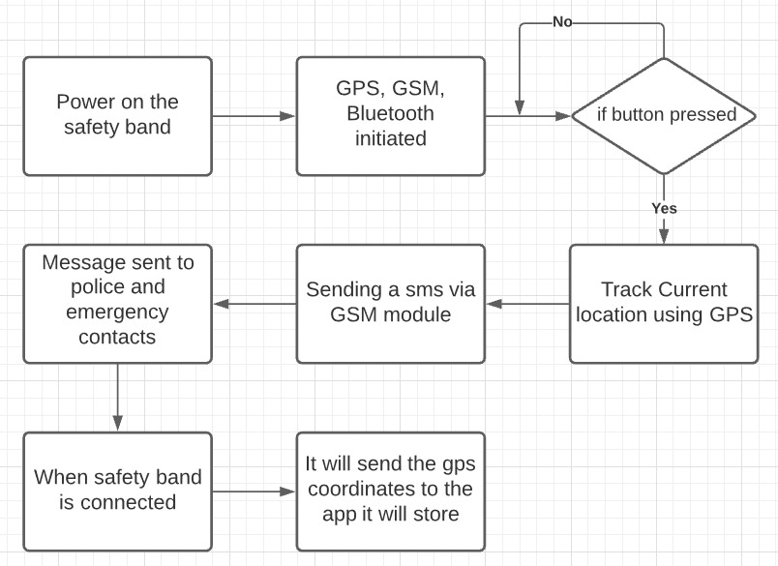
6. Proposed System Architecture/Working
Block Diagram for Safety Band:

Slide 9
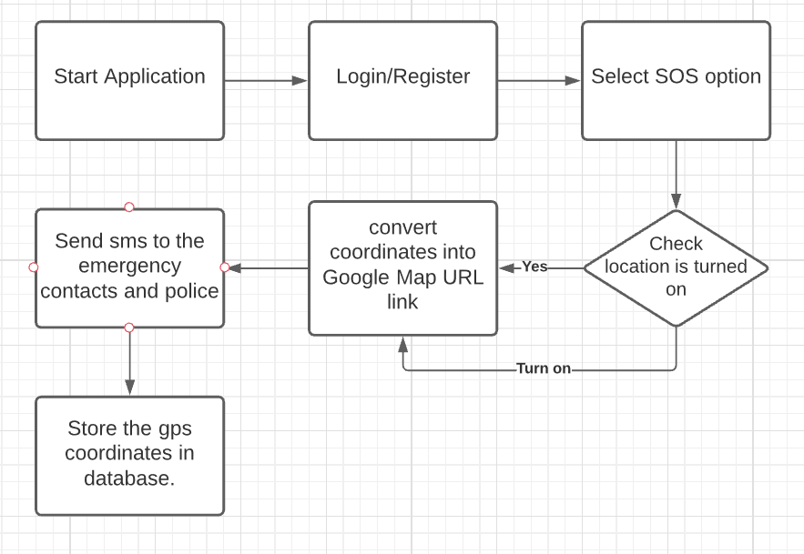
Block Diagram for App:

Slide 10
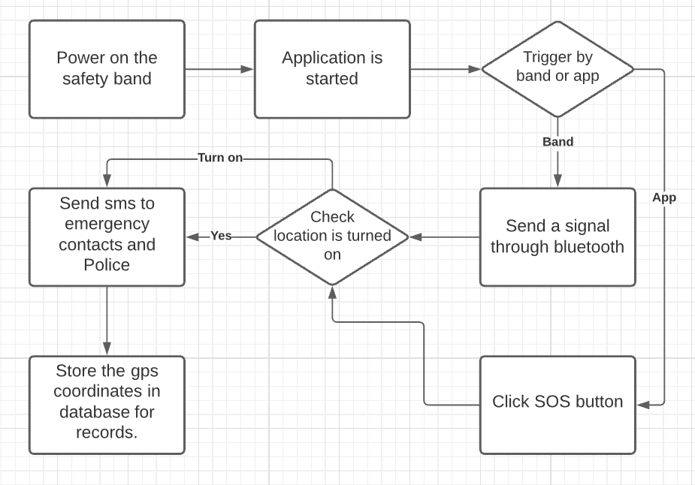
Block Diagram for Safety Band and App:

Slide 11
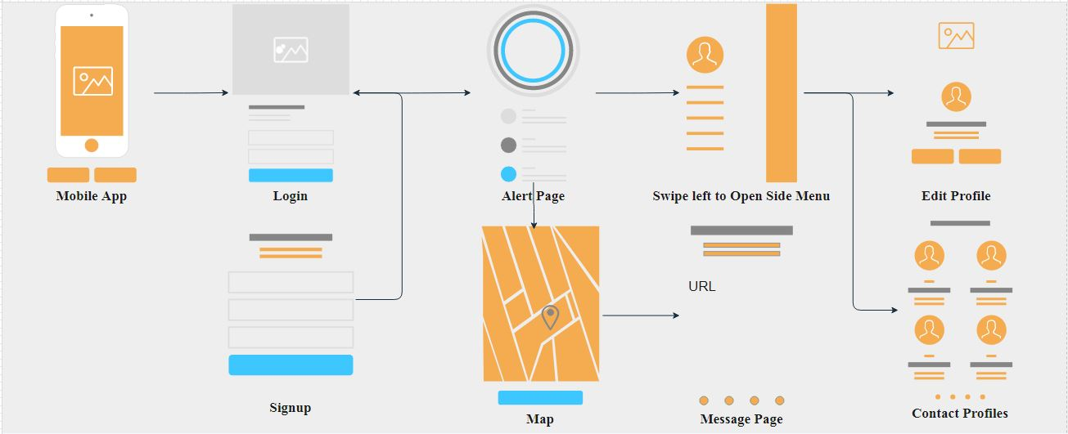
7. Prototype Design Demonstration
Fig:App Flow

Slide 12
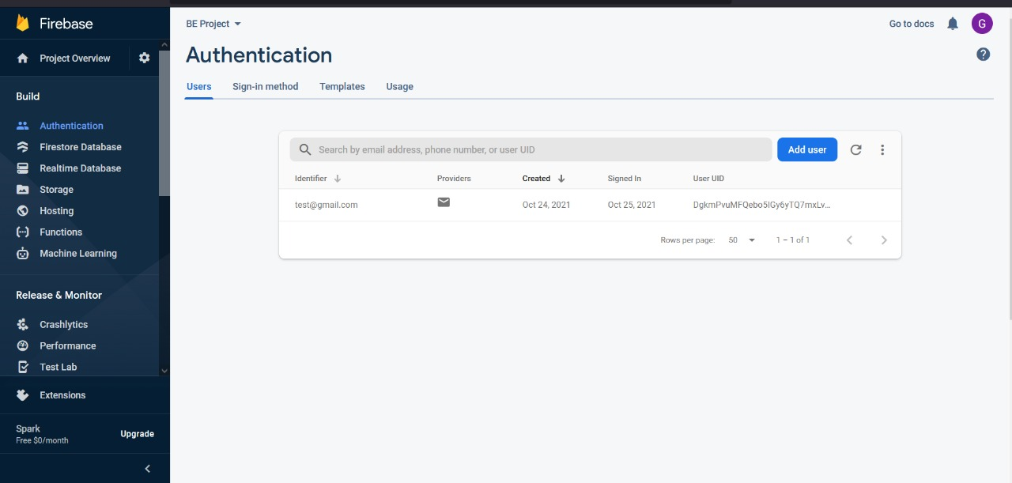
8. Implementation
Fig:App Database

Slide 13
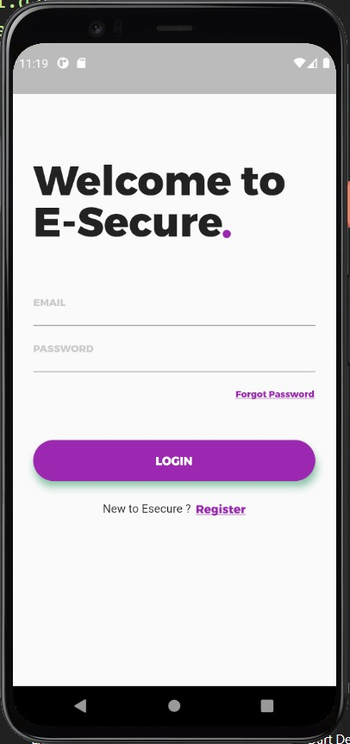
Fig: Login Page

Slide 14
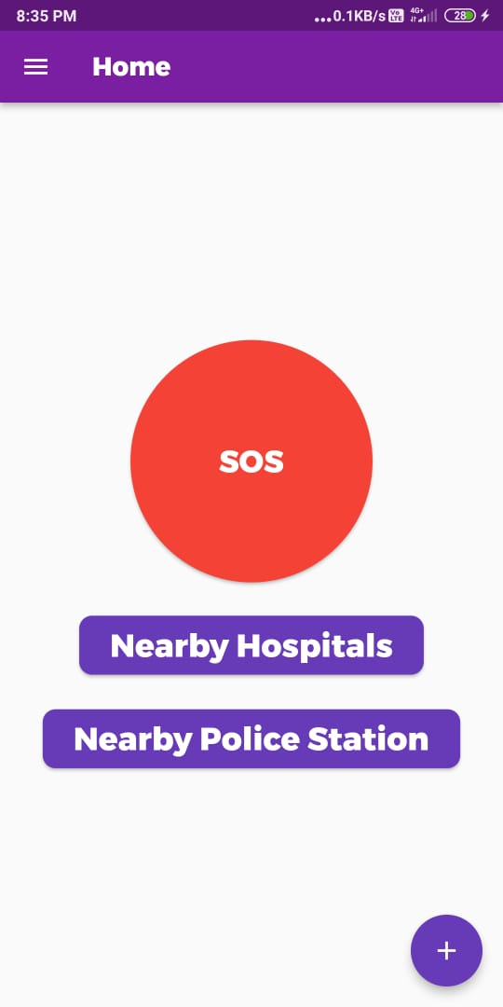
Fig: Home Page

Slide 15
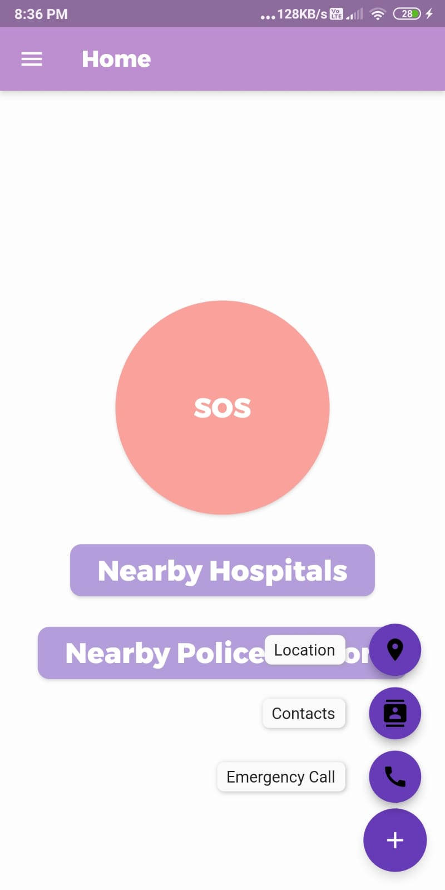
Fig: Speed Dial

Slide 16
9. Status of Paper Draft & Targeted Conference
4th International Conference on Computer Networks, Big Data and IoT ICCBI 2021
Paper Submission Deadline: 29 September, 2021
http://icocbi.com/2021/index.html
ICICV 2022 : 4th International Conference on Intelligent Communication Technologies and Virtual Mobile Networks
Submission Deadline Tuesday 05 Oct 2021
Conference Dates Feb 10, 2022 - Feb 11, 2022
http://icicv.org/2022/
IEEE International Conference on Computing, Communication & Internet of Things Sri Sai Ram Engineering College Chennai, India, March 10-11, 2022
Abstract registration deadline December 1, 2021
Submission deadline December 20, 2021
https://www.ieeeic3iot2022.org/ic3iot-2022

Slide 17
Thank You...!!
Notes:
‹#›

